Slide 1

Discovery of Shared Semantic Spaces for Multi-Scene Video Query
Presented by: Xun Xu
Supervisor: Prof. Shaogang Gong
Dr. Tao Xiang
Independent Assessor: Dr. Timothy Hospedales

Slide 2
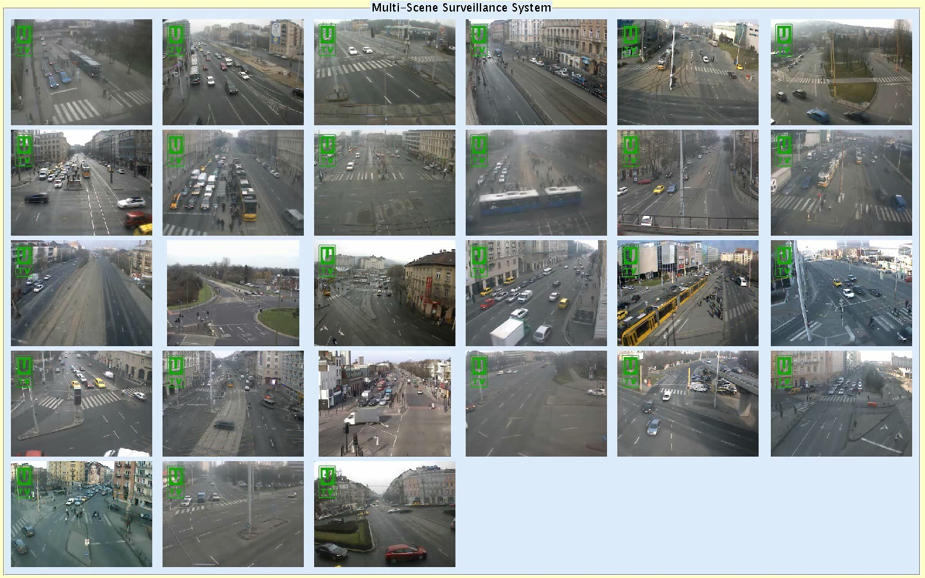
Problem
Tasks:
(1) Behaviour Profiling; (2) Behaviour Query; (3) Classification; (4) Summarization

Slide 3
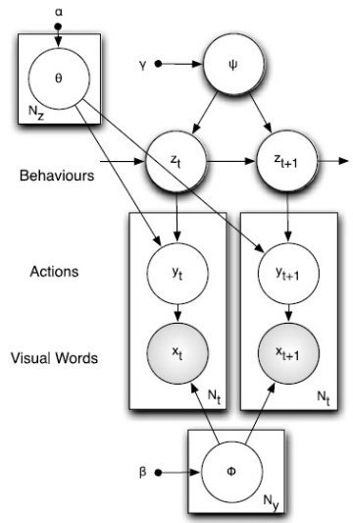
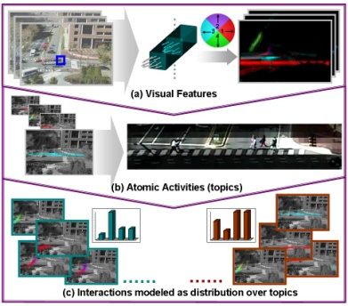
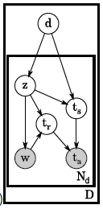
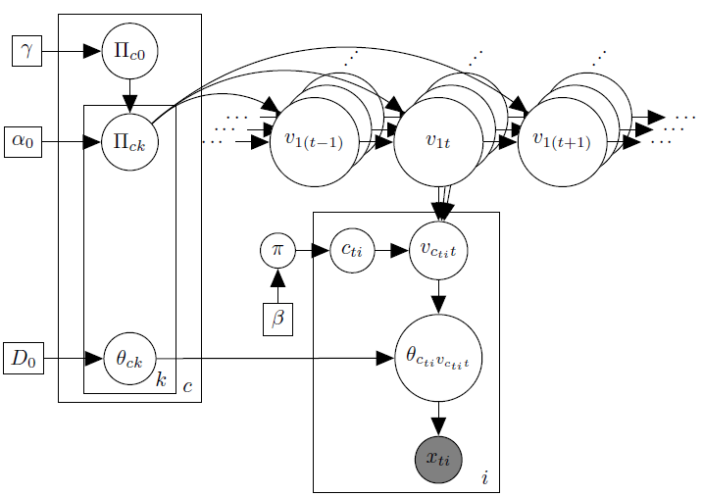
Conventional Approaches
Approaches
Exhaustively annotate each scene
Train independent models
Wang etal. CVPR07
Hospedales etal. IJCV12
Limitations
Discover related scenes
Discover similar activities
Cross-scene query
Multi-scene summarization
Varadarajan etal. IJCV13
Kuettel etal. CVPR10
Wang, Xiaogang, Xiaoxu Ma, and Eric Grimson. "Unsupervised activity perception by hierarchical bayesian models." CVPR07
Hospedales, Timothy, Shaogang Gong, and Tao Xiang. "Video behaviour mining using a dynamic topic model." IJCV12
Varadarajan, Jagannadan, Rémi Emonet, and Jean-Marc Odobez. "A sequential topic model for mining recurrent activities from
long term video logs." IJCV13
Kuettel, Daniel, et al. “What‘s going on? Discovering spatio-temporal dependencies in dynamic scenes.” CVPR10

Slide 4
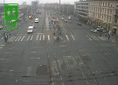
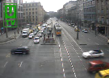
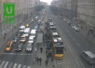

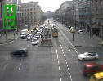

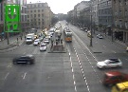
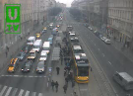
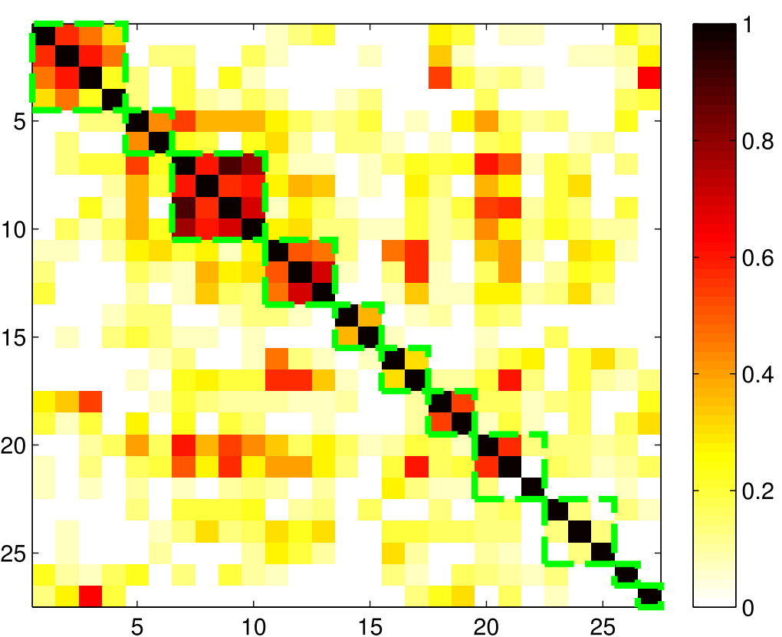
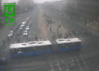
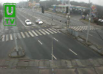
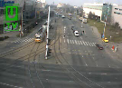


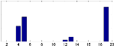
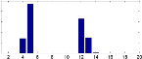
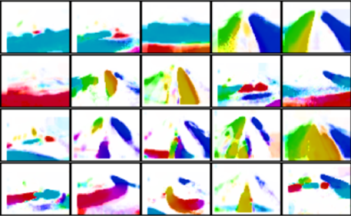
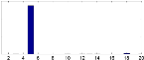
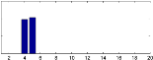
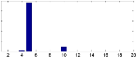
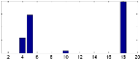
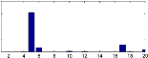
Multi-Scene Approach
Challenges
Compute Scene Relatedness
Selective Sharing Information
Construct a Shared Representation
Local Representations
Scene Level Clustering
Scenes in one Cluster
…
Addressed Problems
Behaviour as Shared Profile
Shared Representation
Cross-Scene Query by Example
Cross-Scene Classification
Multi-Scene Video Summarization

Slide 5
Local Activities
Learning Local Activities
Local Representations
Scene Level Clustering
Scenes in one Cluster
…
Addressed Problems
Behaviour as Shared Profile
Shared Representation
Cross-Scene Query by Example
Cross-Scene Classification
Multi-Scene Video Summarization

Slide 6
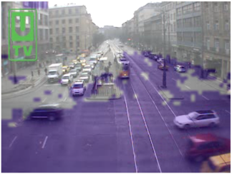
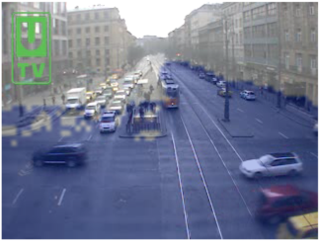
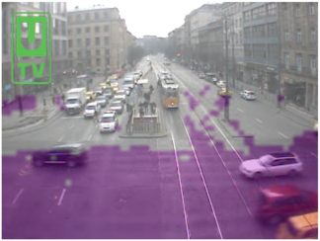
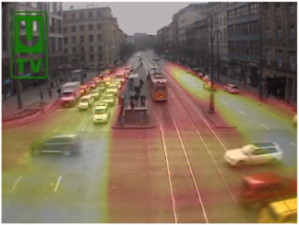
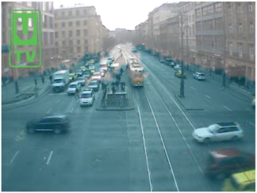
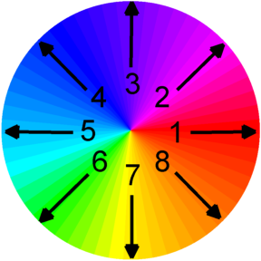
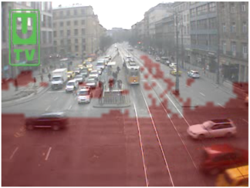
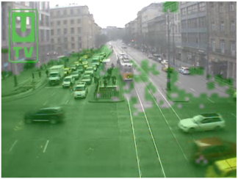
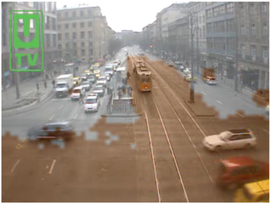
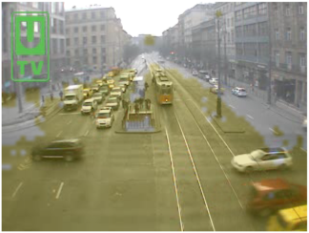
Local Activities
Feature Construction
Quantize Optical Flow into 8 directions
Accumulated Optical Flow

Slide 7
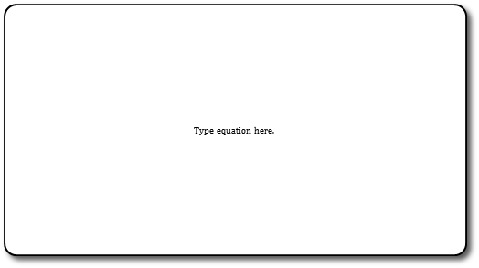



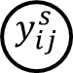
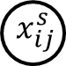
Local Activities
Latent Dirichlet Allocation (LDA)
Dirichlet Prior
Topics/Activities
Activity Distribution in a Video Clip/Document
i=1…N_{j}
j=1….N_{d}
Activity indicator
s=1….M
Variational Inference to Estimate α and β given lots of observed video clips
Quantized Optical Flow Vector

Slide 8
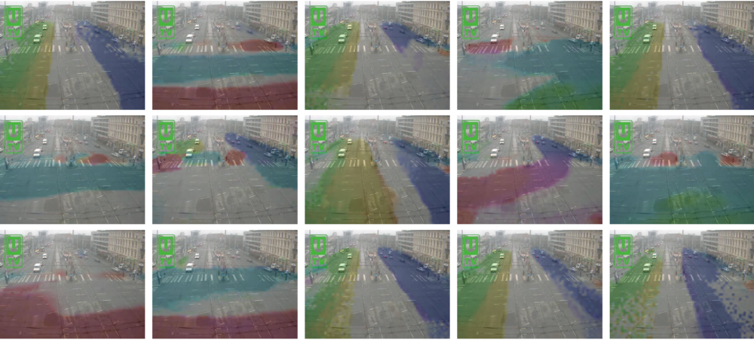
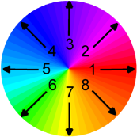
Local Activities
Examples of Local Activities β

Slide 9
Multi-Layer Clustering
Cluster Scenes and learn Shared Topic Basis
Local Representations
Scene Level Clustering
Scenes in one Cluster
…
Addressed Problems
Behaviour as Shared Profile
Shared Representation
Cross-Scene Query by Example
Cross-Scene Classification
Multi-Scene Video Summarization

Slide 10
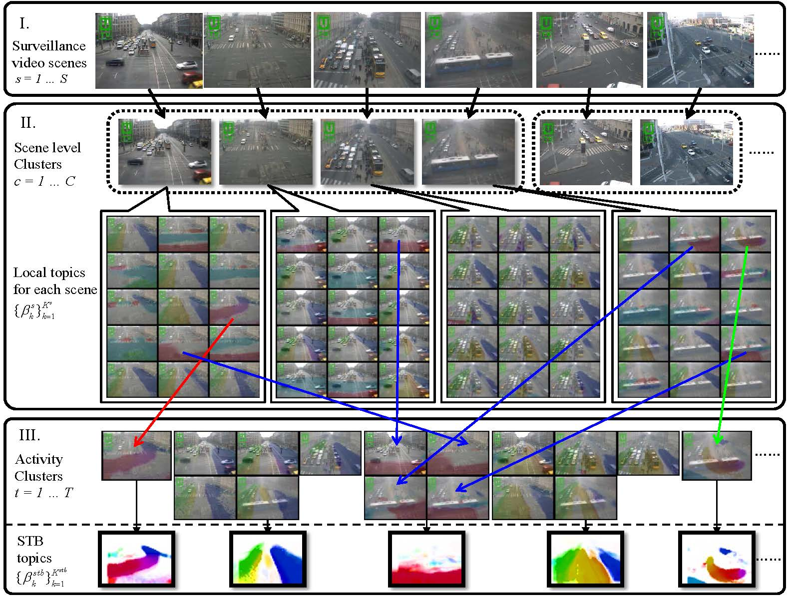
Multi-Layer Clustering

Slide 11
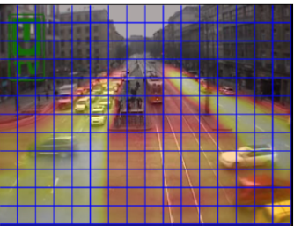
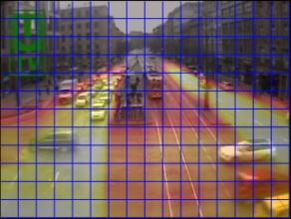
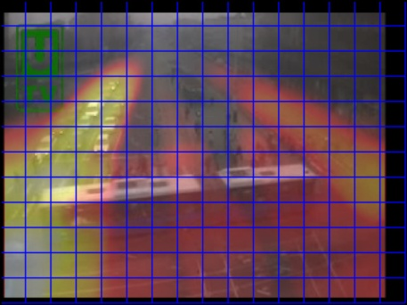
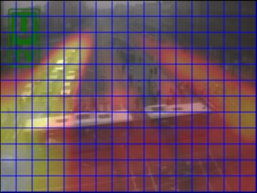
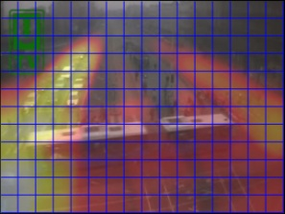
Scene Alignment
Scaling and Translation to align two scenes to remove cross-scene variance
Scene A
Scene A
Scene B aligned to Scene A
Zscore Normalize Optical Flow Vectors
Align Scene B to Scene A
Scene B
Scene B

Slide 12
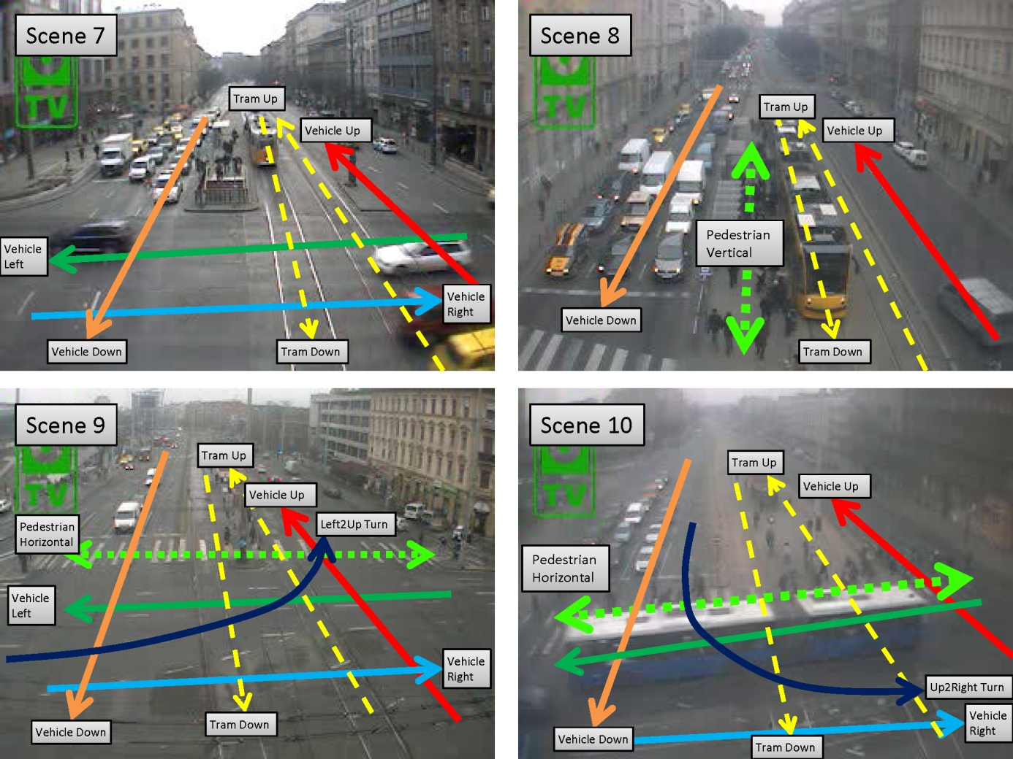
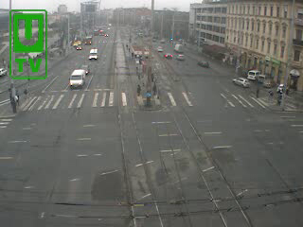

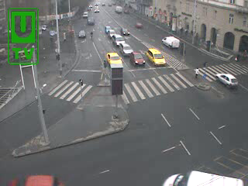
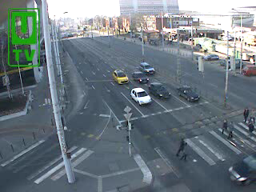
Scene Level Clustering
Scene Relatedness Measurement
#Activities=6
#Activities=7
#Activities=5
#Activities=4

Slide 13
Scene Level Clustering
Scene Relatedness Measurement
#Activities=6
#Activities=7
#Activities=5
#Activities=4
Relatedness:
(6+6)/(6+7)=0.92
(3+3)/(7+5)=0.5
(4+4)/(5+4)=0.89

Slide 14
Scene Level Clustering
Scene Relatedness Measure
Scene Level Clustering
Spectral clustering is used to cluster scenes
#Activities=6
#Activities=7
#Activities=5
#Activities=4
Relatedness:
(6+6)/(6+7)=0.92
(3+3)/(7+5)=0.5
(4+4)/(5+4)=0.89

Slide 15
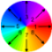














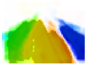





Learning A Shared Topic Basis
A single Shared Topic Basis is learned per scene cluster
STB Topics 1-20

Slide 16


























I.
Surveillance
video scenes
s = 1 … S
……
II.
Scene level
Clusters
c = 1 … C
……
Local topics for each scene
III.
STB Topics 1-20
……
Activity
Clusters
t = 1 … T
STB
topics
……

Slide 17
Behaviour as Shared Profile
Local Representations
Scene Level Clustering
Scenes in one Cluster
…
Addressed Problems
Behaviour as Shared Profile
Shared Representation
Cross-Scene Query by Example
Cross-Scene Classification
Multi-Scene Video Summarization

Slide 18













Behaviour as Shared Profile
Each clip is represented as a multinomial distribution
Video Clip (Behaviour) Profiled by STB
STB Profile γ as Bar Chart
STB Topics 1-20

Slide 19
Addressed Problems
Local Representations
Scene Level Clustering
Scenes in one Cluster
…
Addressed Tasks
Behaviour as Shared Profile
Shared Representation
Cross-Scene Query by Example
Cross-Scene Classification
Multi-Scene Video Summarization

Slide 20









Cross-Scene Query
Retrieve relevant video clips from other scenes by providing a query clip. L2 or cosine distance is computed on STB profile.
Query Clips
Retrieved Clips from Other Scenes

Slide 21



Cross-Scene Classification
Predict the label of a clip in a new scene given training data from other scenes
Training Data
Testing Data
Scene 1
Scene 2
Knn Classifier
Scene 5
Behav 1
Behav 1
Scene 3
Scene 4
Behav ?
Behav 2
Behav 3

Slide 22




Multi-Scene Summarization
Select K clips to cover as many unique behaviours as possible
Kcenter Clustering:
Select K clips that minimize the farthest distance from any candidate clip to the closest selected clip. Kcenter is good at keeping outliers.
Original Data
Kmeans Result
Kcenter Result
Selected Clip
Selected Clip

Slide 23
Experiment Settings
Dataset
27 real traffic surveillance scenes
Each with 18000 frames in 10 fps. 9000 frames for training and rest for testing
LDA settings:
Optical flow quantize into 8 directions
25 frames per clip/document (360 clips per scene)
# topics = 15
Application Settings:
80 frames per clip/document (112 clips per scene)
Annotations:
6 scenes from two clusters are annotated into 31/59 categories of behaviours

Slide 24

Multi-Scene Profiling

Slide 25

Cross-Scene Query

Slide 26

Cross-Scene Query
Comparison of Models:
Flat Model (FM): without multi-layer clustering.
Our Scene Cluster Model (SCM): with multi-layer clustering.
Evaluation: Mean Average Precision for first T retrievals

Slide 27

Cross-Scene Classification
Settings: Leave-One-Out Cross-Validation
Evaluation: Average Accuracy
Comparison of Models:
Flat Model (FM): without multi-layer clustering.
Our Scene Cluster Model (SCM): with multi-layer clustering.

Slide 28
Multi-Scene Summarization
Settings: Select K clips from all video clip across 6 scenes
Evaluation: The percentage of covered unique behaviours in summary
Comparison of Scene Model:
Single Scene: concatenate summary from each single scene
Flat Model (FM): without multi-layer clustering.
Our Scene Cluster Model (SCM): with multi-layer clustering.
Comparison of Summarization Models:
Random
User Attention
Graph Cut

Slide 29

Multi-Scene Summarization
Scene Cluster 3 (4 scenes in total)

Slide 30

Multi-Scene Summarization
Scene Cluster 7 (2 scenes in total)

Slide 31

Multi-Scene Summarization
Across Scene Cluster 3 and 7 (6 scenes in total)

Slide 32

Multi-Scene Summarization

Slide 33
Conclusions
Proposed to model multiple scenes jointly
Discover scene relatedness by matched topic pairs
Discover shared activities across scenes
Multi-scene Activity Profiling
Cross-scene Query
Cross-scene Classification
Multi-scene Summarization

Slide 34
Thank You

